Slide 1

The Prediction of Electric Vehicle Penetration and Electricity Consumption in Florida
Majed Alkhasha
Slun Booppasiri
Mengling He
Rui Yang

Slide 2
Background
An electric vehicle (EV) is a vehicle that uses one or more electric motors or traction motors for propulsion.
Technology improvements, cost reduction, increasing model choice, maturing charging infrastructure, and economic recovery have continued to influence and support increased sales of EVs.
According to the International Energy Agency (IEA), 17,000 electric cars were on the world's roads in 2010, and in 2019 electric car sales reached 2.1 million, bringing the total number of electric vehicles on the world's roads to 7.2 million.
As in US, there will be around 4 million EVs in California alone by 2030, and Florida has the second highest number of EVs behind California.
Notes:
During the last few decades, ecological damage and climate change caused by the petroleum-based transportation infrastructure, along with the fear of peak oil, has led to interest in electric transportation vehicle.
EV is now playing an increasing important role in the transportation vehicles these years.

Slide 3
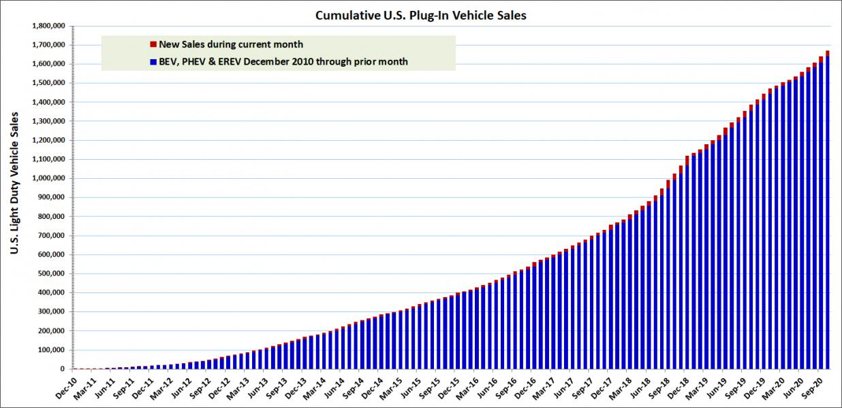
MOTIVATION
How to support the increasing electric vehicle market
EV Production
Power supplies
Charging infrastructure
……
takes only 2% of the market
Notes:
The EV forecasts are critical information for utility companies because they need to provide sufficient power supplies, maintain energy affordability, and preserve the reliability of the electric grid for future usage. In addition, the government also needs to know the EV trends to make appropriate policies and reasonably arrange the position and number of charging infrastructure to meet the expected demand.
With EVs predicted to see substantial growth, how to support the electric vehicle market?

Slide 4
OBJECTIVES
Regional Aspect
How the regional demographics will impact the EV amount?
Household Aspect
How to predict whether a household has an EV?
The electricity consumption prediction for EV owners
Notes:
?

Slide 5
Data Set 1
Variable name | Description of the variables (unit)
State | State Name of The U.S.
Registration_Count | Electric Vehicle Registrations by State
Density | Population Density (p/mi²)
Pop | Population of each States
LandArea | Land Area (mi²) of each States
Income | The median House income (dollars)
PercentHighSchoolOrHigher | The percentage of the whole state population who have high school degrees or higher degrees
PercentBachelorsOrHigher | The percentage of the whole state population who have bachelor’s degrees or higher degrees
Average_retail_price | The average price of the electricity for each state (cents/KWH)
Total_retail_sales | Total electricity usage of each state per year (MWH)
charging_stations | The charging station number of each state
incentives_policy | The incentives policy number of each state
Annual_AVG_Fahrenheit | The average annual temperature of each state (F)
Winter_AVG_Fahrenheit | The winter average temperature of each state (F)
Registration_Per_1000 (dependent variable) | Registration Count/population*1000 (EV registration numbers per 1000 people)

Slide 6
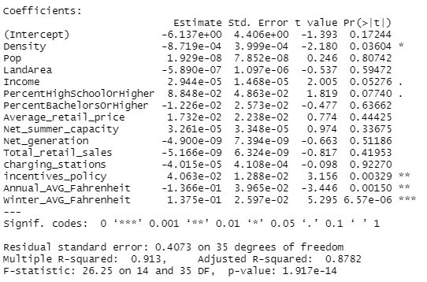
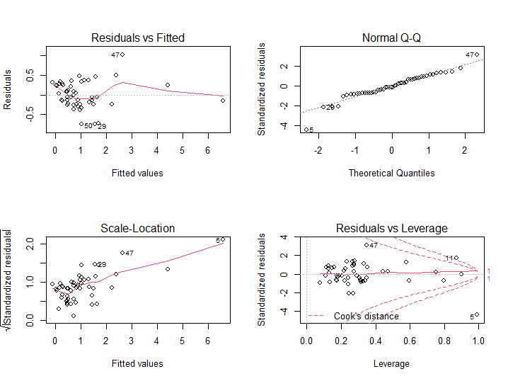

Variable Transform and Selection
$R^{2}$= 0.913
AIC = 66.23444

Slide 7
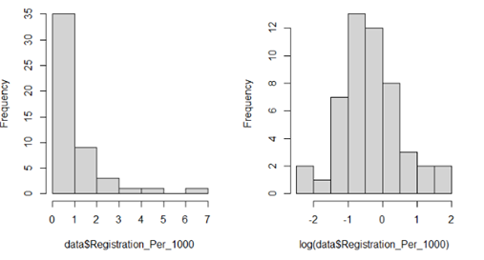
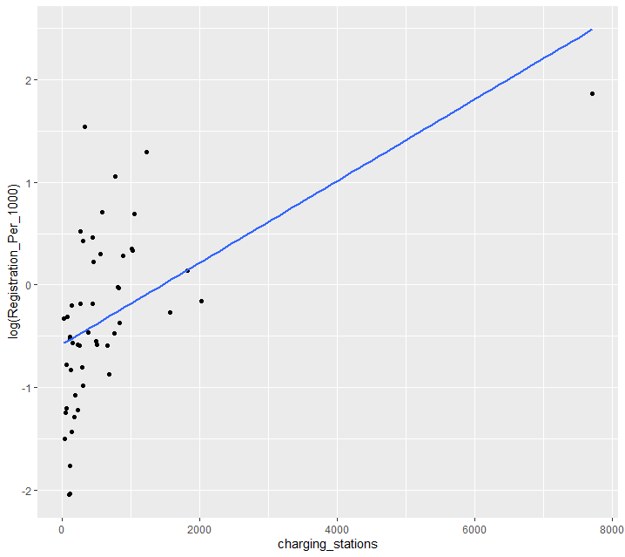
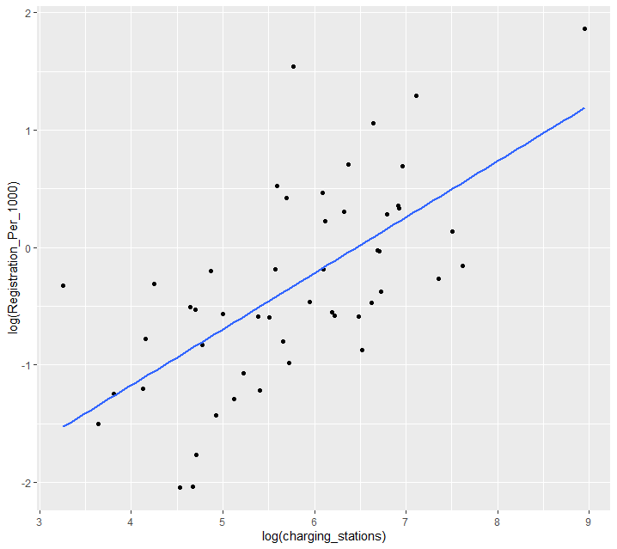
Variable Transform and Selection
charging_stations → log(charging_stations)
log(Registration_Per_1000)
log(Density)
log(Pop)
log(LandArea )
log(charging_stations)
log(incentives_policy)

Slide 8
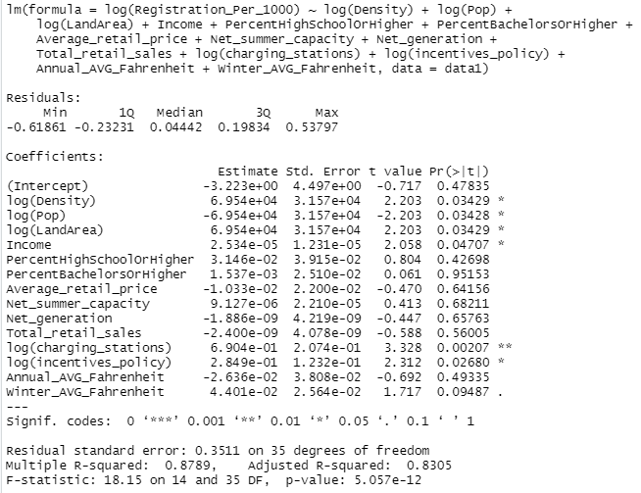
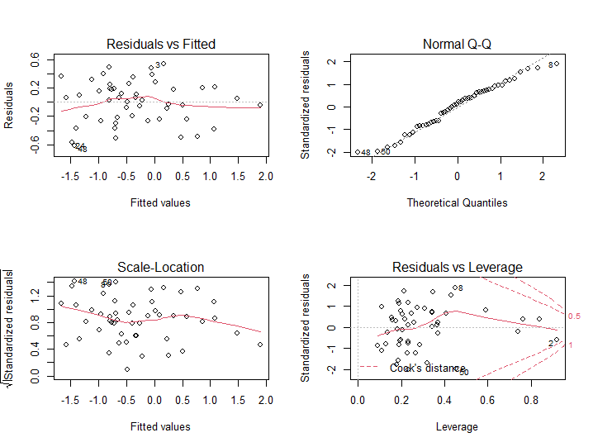
Variable Transform and Selection
𝑅^2= 0.8789
AIC = 51.38949

Slide 9
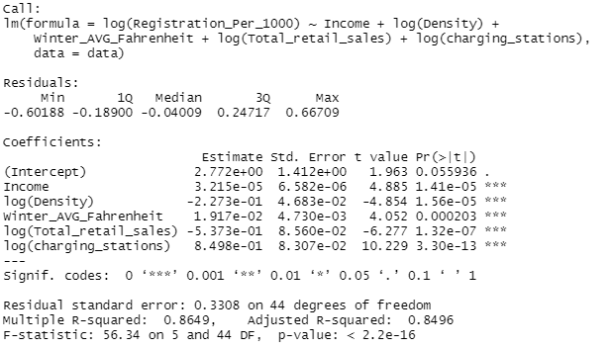
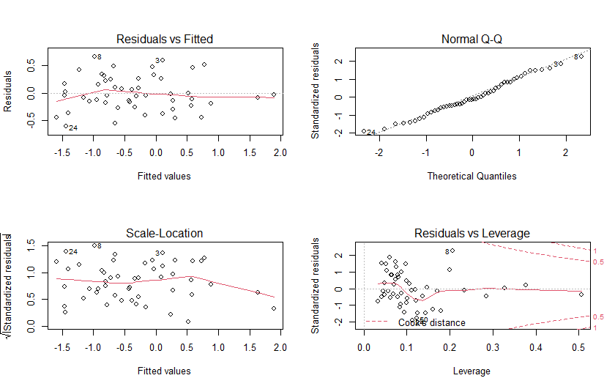


Linear Model of Data 1
$R^{2}$= 0.8649 F-value = 56.34 p-value $≈ 0$
AIC= 38.86794

Slide 10
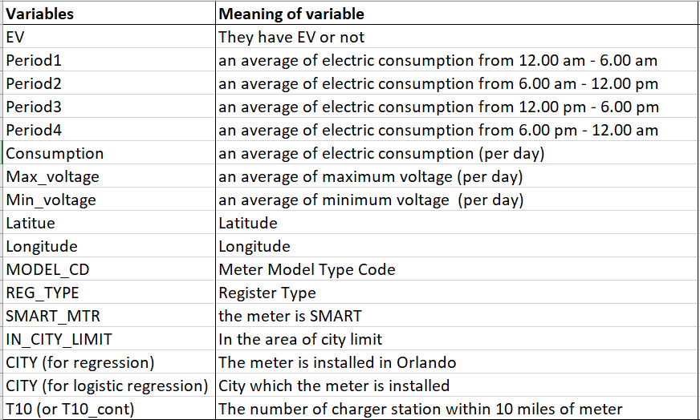
Data Set 2

Slide 11
Descriptive statistics

Slide 12
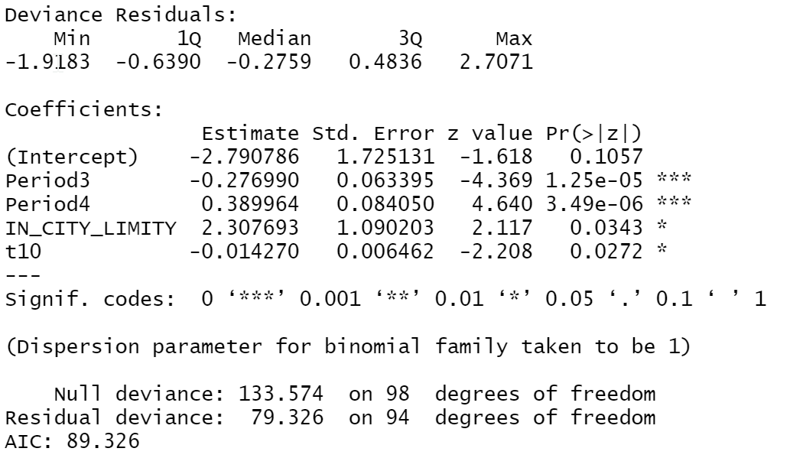
Logistic Regression

Slide 13
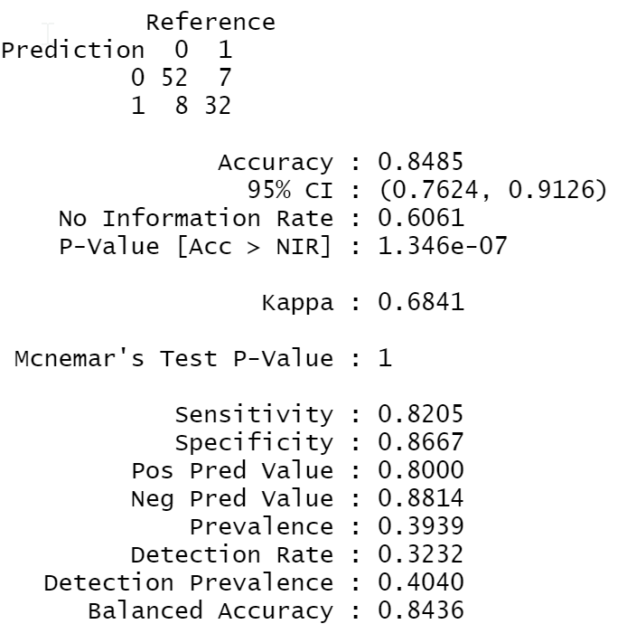
Confusion Matrix

Slide 14
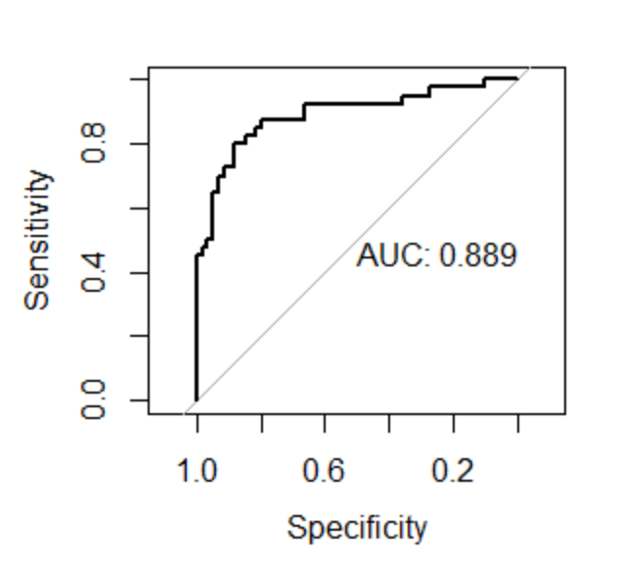
ROC curve

Slide 15
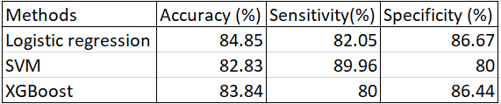
Compare with SVM and XGboost

Slide 16
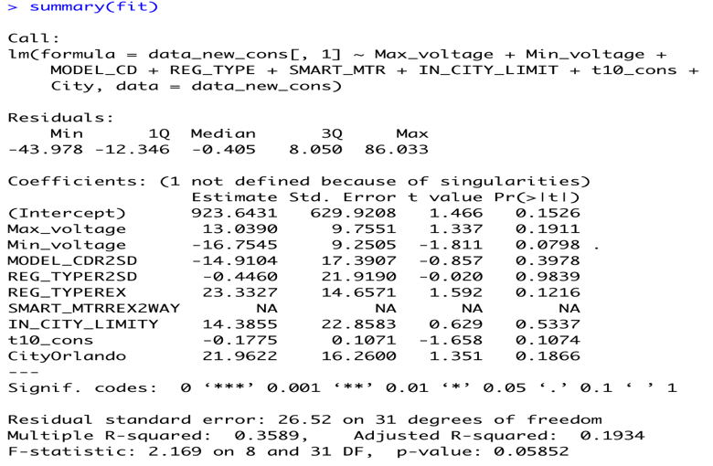
preliminary multiple regression model

Slide 17
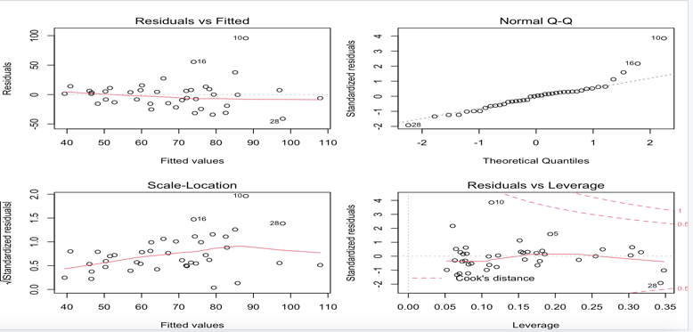
preliminary multiple regression model

Slide 18
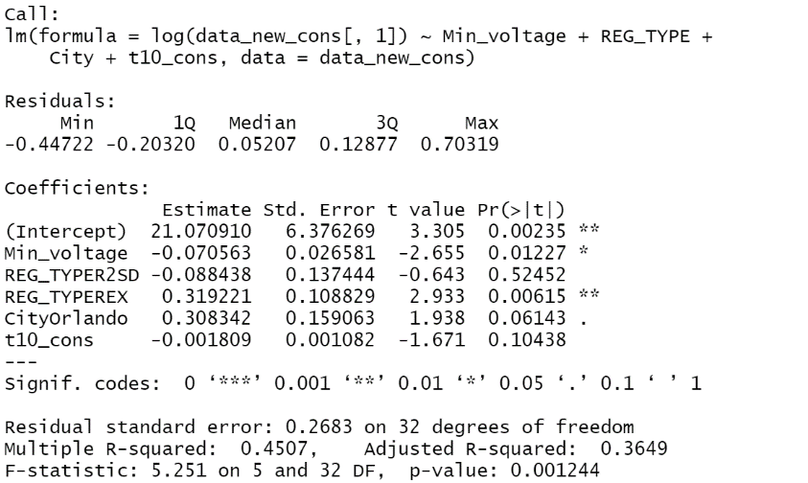
final model

Slide 19
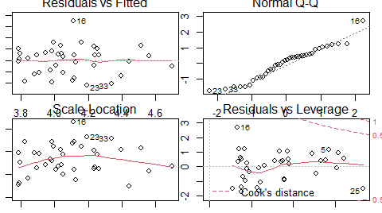
final model

Slide 20
Conclusions and limitation
Income, density of population, average temperature in winter and total of retail sale is a predictor of EV registration.
For logistic regression, electric consumption from midday to midnight, area of city limit and the number of charging station within 10 miles is a significant predictor for predict household that have EV or not.
For 3rd analysis, minimum voltage, type of meter, area of city limit, and the number of charging station within 10 miles can be a predictor of electric consumption.
the easy accessibility to charging stations can also help to promote the EV market
The small number of EV user data.

Slide 21
Future study
make the map of EV owner, the charging stations, and house price to find out the potential EV buyer location and the better locations to install charging infrastructures
establish the model and help the electricity company or the local government to decide how many and where to set the charging station

Slide 22
References
U. Eberle, and R. Helmolt, “Sustainable transportation based on EV concepts: a brief overview, “ Energy & Environmental Science, Vol.3 (6), pp. 689–699. May 2010.
D. Gohlke and Y. Zhou, “Assessment of Light-Duty Plug-in Electric Vehicles in the United States, 2010 – 2019,” Argonne National Laboratory, Lemont, IL USA, doi:10.2172/1642114, June 2020.
IEA (2020), Global EV Outlook 2020, IEA, Paris https://www.iea.org/reports/global-ev-outlook-2020.

Slide 23
Thank You!

